Slide 1


Edgar F Jacobi
11/08/2022

Slide 2

Outline (Contents)
Executive Summary ---------------------------------------- page 3
Introduction ------------------------------------------------- page 4
Section 1 Methodology -------------------------------- page 5
Results ------------------------------------------------------- page 31
Section 2 Insights drawn from EDA ------------------ page 32
Section 3 Launch Sites Proximities Analysis -------- page 55
Section 4 Build a Dashboard with Plotly Dash ----- page 65
Section 5 Predictive Analysis (Classification) ------- page 69
Conclusions -------------------------------------------------- page 72
Appendix ----------------------------------------------------- page 74

Slide 3
Executive Summary
Summary of methodologies
The goal of this Capstone Project is to predict if the first stage of a SpaceX Falcon 9 rocket will land (i.e., will be recovered for re-use) successfully. Stakeholders such as SpaceY can save more than $100 million per launch with each of these successful recoveries (successful ‘landing outcomes’).
To accomplish this prediction, we collected Falcon 9 launch data from public SpaceX API and SpaceX Wikipedia pages. We created labels for a binary ‘class’ which classifies successful and unsuccessful landings and explored the launch data using SQL, visualization, folium maps, and dashboards. Then Machine Learning Classification techniques were used for predicting the class or category of the outcome. Gathered relevant data columns to be used as features. Changed all categorical variables to binary using one hot encoding. Standardized the data and used GridSearchCV to find the best parameters for machine learning models. We determined the accuracy score of all models in predicting first stage landing outcomes (successful = 1, unsuccessful = 0).
Summary of all results
Four machine learning classification models were created : Logistic Regression, Support Vector Machine, Decision Tree Classifier, and K Nearest Neighbors. All produced similar results with a prediction accuracy rate of about 83% or greater. But all the models over-predicted successful landings. More data is needed for better model determination and accuracy in predicting first stage landing outcomes.

Slide 4
Introduction
Project background and context
SpaceX has led the nation into the Commercial Space Age. SpaceX advertises Falcon 9 rocket launches on its website with a cost of 62 million dollars each; other providers’ launches cost upward of 165 million dollars each. SpaceX can recover and reuse the rocket first stage. So Falcon 9 first stage landing results in the lower cost launches. Therefore, if we can determine if a future first stage will land successfully, we can determine the cost of a launch. This information can be used by another company, SpaceY, which may want to compete with SpaceX for a rocket launch(es). The goal of this project is to create a machine learning pipeline to predict if the first stage will land successfully for SpaceY.
Problem to be solved
What rocket launch factors determine if the rocket first stage will land successfully?
Find the interaction among the various rocket launch data features that determine the rate of successful landings.
What operating conditions need to be in place to ensure a successful landing program.

Slide 5

Section 1

Slide 6
Methodology
Data collection methodology:
Data was collected using recent SpaceX API JSON data and web scraping launch data in the List of Falcon 9 and Falcon Heavy Launches Wikipedia Page. A SpaceX launch dataset was formed.
Performed data wrangling
One-hot encoding was applied to categorical features of the SpaceX dataset. We classified Falcon 9 first stage landings as successful or unsuccessful (one or zero).
Performed exploratory data analysis (EDA) using visualization and SQL
Performed interactive visual analytics using Folium and Plotly Dash

Slide 7
Methodology (cont’d)
Performed predictive analysis using classification models
We split the launch dataset into training and testing data using the ‘train_test_split’ function. The training data was divided into validation data and a second training set. Then classification models were trained and hyperparameters were selected using the sklearn GridSearchCV function.

Slide 8
Data Collection Overview
The data was collected using various methods (REST API and web scraping)
First data was collected using the ‘get_request’ on the SpaceX public API.
Then we formed a pd.dataframe from the response_content using the ‘.json()’ function call and turned it into a dataframe using ‘.json_normalize()’.
We formed a dataframe of relevant data:
SpaceX API Relevant Columns:
FlightNumber, Date, BoosterVersion, PayloadMass, Orbit, LaunchSite, Outcome, Flights, GridFins, Reused, Legs, LandingPad, Block, ReusedCount, Serial, Longitude, Latitude

Slide 9
Data Collection Overview (cont’d)
The data was collected using various methods (web scraping)
In addition, we performed web scraping from Wikipedia for Falcon 9 launch records (List of Falcon 9 and Falcon Heavy launches) with BeautifulSoup.
We extracted the launch records as an HTML table, parsed the table and converted it to a pandas dataframe for future analysis.
SpaceX Wikipedia Webscrape DataFrame Columns:
Flight No., Launch site, Payload, PayloadMass, Orbit, Customer, Launch outcome, Version Booster, Booster landing, Date, Time

Slide 10
Data Collection (cont’d)
SpaceX REST API data collection process using key phrases and flowcharts
SpaceX
API
URL
Request.get
URL
Form json from Request
AppIy
Json_normalize
to Form
Pd.dataframe
Form dictionary of relevant
launch data
Cast dictionary to a dataframe
Filter launch data to only Falcon 9
Fill in missing PayloadMass values with mean
Store Falcon 9 data as .csv file

Slide 11
Data Collection – SpaceX API
data collection with SpaceX REST calls using key phrases and flowcharts :
the GitHub URL of the completed SpaceX API calls :
Please See previous slides (pages 8, 9, 10)
GitHub url:
https://github.com/efjacobi/IBM-Professional-Certificate-DS-CAPSTONE-efjacobi/blob/master/Data%20Science%20CAPSTONE%20API%20Collect%20%201st%20Lab.ipynb

Slide 12
Data Collection – Web Scraping
The web scraping process using key phrases and flowcharts :
The GitHub URL of the completed web scraping notebook is (below):
https://github.com/efjacobi/IBM-Professional-Certificate-DS-CAPSTONE-efjacobi/blob/master/Data%20Science%20CAPSTONE%20Web%20Scrap%202nd%20Lab.ipynb
SpaceX Falcon 9
Wikipedia
Page
RequestWikipedia
html
Parse with BeautifulSoup html5lib
Find_all launch data table
Create launch dictionary (dict)
Fill launch dict with data from table rows
Cast launch dict to DataFrame
Store launch data as .csv file

Slide 13
Data Wrangling
Performed exploratory data analysis to determine training labels for Falcon 9 first stage landing outcomes.
We calculated the number of launches at each site, and the number and occurrence of each orbit
We calculated the number and occurrence of mission outcomes per orbit type
Created a landing outcome label from the outcome column:
Outcome column has two components: ‘Mission Outcome (True, False, None)’ ‘Landing; Location (ASDS, RTLS, Ocean, None)’
None None, False ASDS, None ASDS, False Ocean, False RTLS –> ‘bad_outcome’ --> 0
True ASDS, True RTLS, True Ocean --> ‘otherwise’ --> 1

Slide 14
Data Wrangling (cont’d)
None None, False ASDS, None ASDS, False Ocean, False RTLS –> ‘bad_outcome’ --> 0
True ASDS, True RTLS, True Ocean --> 1
So we got the results:
Training labels : ‘bad_outcome’ = 0 or ‘otherwise’ = 1
Added a column to launch dataframe for landing_class using outcomes training label. Column named ‘Class’.
Exported the resulting dataframe to .csv file.

Slide 15
Data Wrangling (cont’d) Flowchart
Create landing outcome training label
SpaceX Falcon 9
.csv dataset (dataframe)
Idenify first stage landing outcomes
False ASDS, False Ocean, False RTLS, None ASDS, None None
= 0
LaunchSite
Count launches
Mission Outcomes per orbit type
Create landing_class
Attribute column of 1’s and 0’s
True ASDS, True RTLS, True Ocean
= 1
Orbits
Count
orbits
Append column to dataframe as ‘Class’
Store ‘new’ dataframe as .csv file

Slide 16
Data Wrangling (cont’d)
GitHub URL of the completed Data Wrangling notebook :
https://github.com/efjacobi/IBM-Professional-Certificate-DS-CAPSTONE-efjacobi/blob/master/Data%20Science%20CAPSTONE%20Data%20Wrangle%20%203rd%20Lab.ipynb

Slide 17
EDA with Data Visualization
Here we summarize what charts were plotted and why these charts were used:
In this Capstone Exploratory Data Analysis we performed visualization on variables Flight Number, the launch Year, Payload Mass, Launch Site, Orbit type, and Class (landing outcome).
Plots Used:
Flight Number vs. Payload Mass, Flight Number vs. Launch Site, Payload Mass vs. Launch Site, Orbit vs. Success Rate, Flight Number vs. Orbit, Payload vs Orbit, and Success Rate Yearly Trend. Scatter plots, line charts, and bar plots were used to compare relationships between these variables to decide if a relationship exists for use in training the machine learning model.
These EDA plots are shown in the Results Section ( beginning at Page 33 of this report)
Add the GitHub URL of your completed EDA with data visualization notebook, as an external reference and peer-review purpose

Slide 18
EDA with Data Visualization
EDA with Visualization GitHub url:
https://github.com/efjacobi/IBM-Professional-Certificate-DS-CAPSTONE-efjacobi/blob/master/Data%20Science%20CAPSTONE%20Features%20Engr%205th%20Lab.ipynb

Slide 19
EDA with SQL
Using bullet point format, we summarize the SQL queries we performed:
Loaded the Falcon 9 launch data set into IBM DB2 Database using sqlalchemy.
Queried in DB2 using SQL Python integration.
Queries were made to get a better understanding of the SpaceX Falcon 9 launch dataset.
Queried information about launch site names, mission outcomes, various pay load sizes of customers and booster versions, and landing outcomes
For example, we listed the names of the Falcon 9 boosters that had successful ‘ground pad’ landings AND had a payload mass between 4,000 and 6,000 kilograms.

Slide 20
EDA with SQL (cont’d)
Specifically, we wrote queries to learn:
The names of unique launch sites in the space mission.
The total payload mass carried by boosters launched by NASA (CRS)
The average payload mass carried by booster version F9 v1.1
The total number of successful and failure mission outcomes
The failed landing outcomes in drone ship landing, their booster version and launch site names.
These queries are displayed in the Results Section (beginning at Page 41 of this report).

Slide 21
EDA with SQL (cont’d)
EDA with SQL GitHub url:
https://github.com/efjacobi/IBM-Professional-Certificate-DS-CAPSTONE-efjacobi/blob/master/Data%20Science%20CAPSTONE%20SQL%204th%20Lab.ipynb

Slide 22
Build an Interactive Map with Folium
We summarize what map objects such as markers, circles, lines, etc. we created and added to a folium map
We explain why we added those objects
We added the GitHub URL of the completed interactive map with Folium map, as an external reference and peer-review purpose

Slide 23
Build an Interactive Map with Folium
Here we summarize what map objects such as markers, circles, lines, etc. we created and added to a folium map and we explain why we added those objects:
The plots/graphs and interactions we visualized using Folium:
We marked all launch sites, and added map objects such as markers, circles, lines to mark the success or failure of launches for each site on the Folium map.
We assigned the feature launch outcomes (failure or success) to class 0 and 1, i.e., 0 for failure, and 1 for success.
Using the color-labeled marker clusters, we identified which launch sites have high success rate(s).
We calculated the distances between a launch site and its proximities. For example, we investigated:
Are launch sites near railways, highways and coastlines?
Do launch sites keep certain distance away from cities?

Slide 24
Build an Interactive Map with Folium (cont’d)
Specifically, with Folium maps we marked Launch Sites, successful and unsuccessful landings, and a proximities to key locations: Railway, Highway, Coast, and City.
This allows us to understand why launch sites may be located where they are. Also visualizes successful landings relative to location.
These maps are displayed in the Results Section (beginning at Page 55 of this report).
GitHub Foliuim Maps url:
https://github.com/efjacobi/IBM-Professional-Certificate-DS-CAPSTONE-efjacobi/blob/master/CAPSTONE%20VIS%20ANAL%20w%20FOLIUM%20LAB%206.ipynb
Please Note: To see the maps created by ‘efjacobi’ in the GitHub Folium .ipynb notebook, go to the github editor and ‘Open in github.dev’ .

Slide 25
Build a Dashboard with Plotly Dash
Here we summarize what plots/graphs and interactions we have added to a Plotly Dash dashboard. We also explain why we added those Plotly Dash plots and interactions.
We built an interactive dashboard with Plotly dash
We plotted pie charts showing the total launches by sites
We plotted scatter graph showing the relationship with Outcome and Payload Mass (Kg) for the different booster version.

Slide 26
Build a Dashboard with Plotly Dash (cont’d)
Specifically, the dashboard includes a pie chart and a scatter plot.
Pie chart can be selected to show distribution of successful landings across all launch sites and can be selected to show individual launch site success rates.
Scatter plot takes two inputs: All sites or individual site and payload mass on a slider between 0 and 10000 kg.
The pie chart is used to visualize launch site success rate.
The scatter plot can help us see how success varies across launch sites, payload mass, and booster version category.

Slide 27
Build a Dashboard with Plotly Dash (cont’d)
These Dashboards are displayed in the Results Section (beginning at Page 65 of this report).
Dashboard with Plotly Dash GitHub url:
https://github.dev/efjacobi/IBM-Professional-Certificate-DS-CAPSTONE-efjacobi/blob/master/edgar%20dash%20app%20text.txt

Slide 28
Predictive Analysis (Classification)
This summarizes how we built, evaluated, improved, and found the best performing classification model. We present our model development process using key phrases and a flowchart.
We loaded the data as dataframe from previously stored Falcon 9 launch dataset_part_2.csv, transformed the data using sklearn StandardScaler(), split our data into training and testing datasets using the train_test_split() function.
We built and tuned different machine learning models with different hyperparameters using GridSearchCV. In that way we found the optimal hyperparameters for each model we tested.
Improved the model using feature engineering and algorithm tuning. We used .predict to obtain predictive estimates of Falcon 9 landing outcomes (0 or 1). We used best_score_ as the metric for our model(s) accuracy when comparing test set outcomes (Y_test) to estimated outcomes (yhat). We also formed a confusion matrix for visualizing the results of each model.
Then we found the best performing classification model of the four we tested: logistic regression, support vector machine, decision tree, and k nearest neighbor.

Slide 29
Predictive Analysis (Classification) Flowchart
Falcon 9 first stage landing prediction process using key phrases and flowcharts
Load dataset_part_2.csv
Train_test_split the features dataset
Apply GridSearchCV
Using cv = 10
To find best hyperparameters
For classification models
Create Numpy Array Column ‘Class’
Load ‘features’
dataset_part_3.csv
Fit and transform features using StandardScaler
By GridSearchCV run various models (LogReg, SVM, DecisionTree, KNN)
Find best_score_ on ‘Y_test’ dataset for each model
Build confusion matrix to visualize results of each model
Find the ‘best_score_’ classification model

Slide 30
Predictive Analysis (Classification) (cont’t)
These Predictions are displayed in the Results Section (beginning at Page 69 of this report).
GitHub url for Predictive Analysis (Classification:
https://github.com/efjacobi/IBM-Professional-Certificate-DS-CAPSTONE-efjacobi/blob/master/Data%20Science%20CAPSTONE%20ML%20Prediction%207th%20Lab.ipynb

Slide 31
Results
Exploratory data analysis results
Interactive analytics demo in screenshots
Predictive analysis results

Slide 32

Section 2

Slide 33
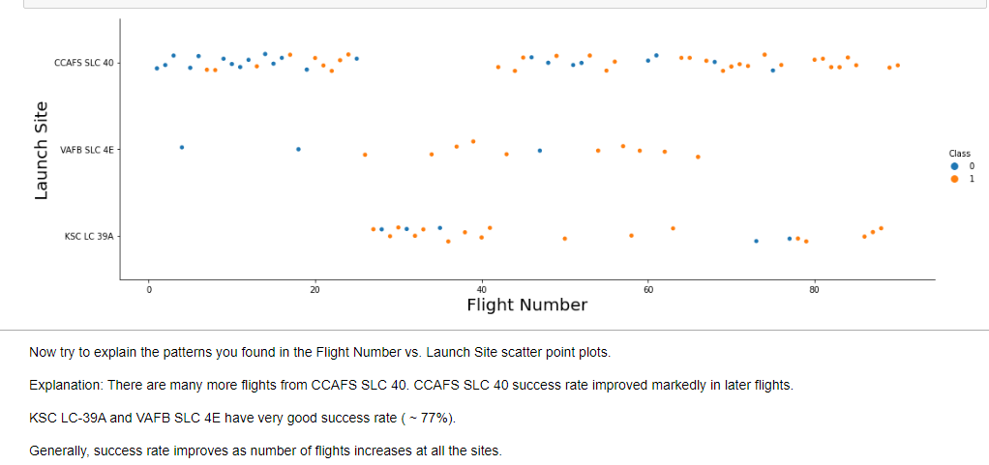
Flight Number vs. Launch Site Scatter Plot
33

Slide 34
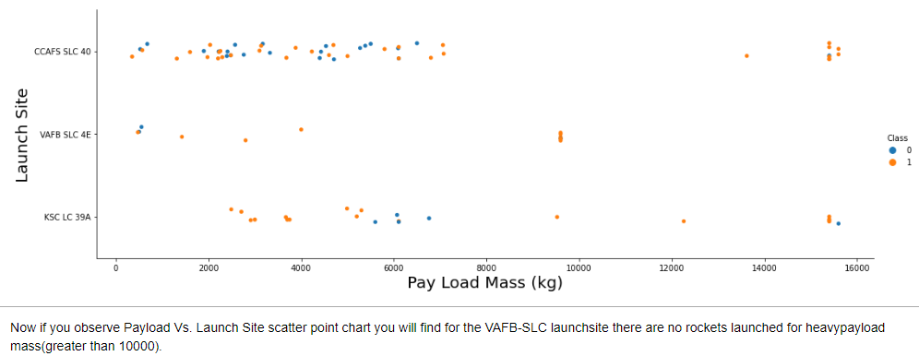
Payload vs. Launch Site Scatter Plot
Also, for launch sites CCAFS SLC 40 and KSC LC 39A, first stage recoveries at large payloads
(pay load mass > 12000 kg) are quite good. Yet more data (more launches) are needed to bear this out.

Slide 35
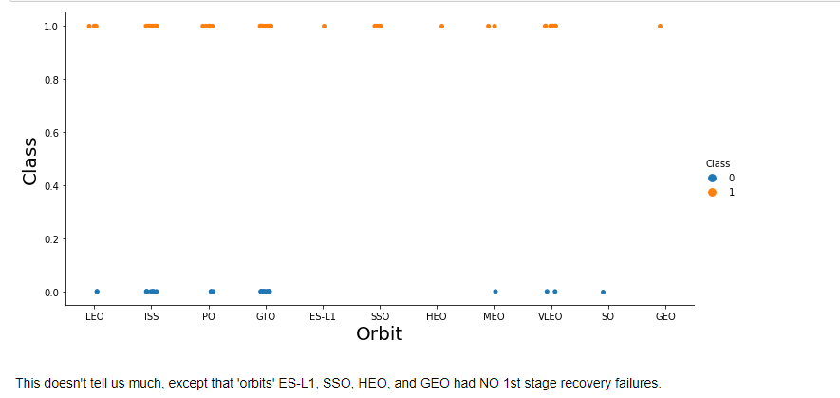
Success Rate vs. Orbit Type Scatter Plot
ES-L1, HEO, and GEO had but one launch data point each. Not enough data to draw conclusions. So let’s move on to a bar chart for another way to view the data.

Slide 36
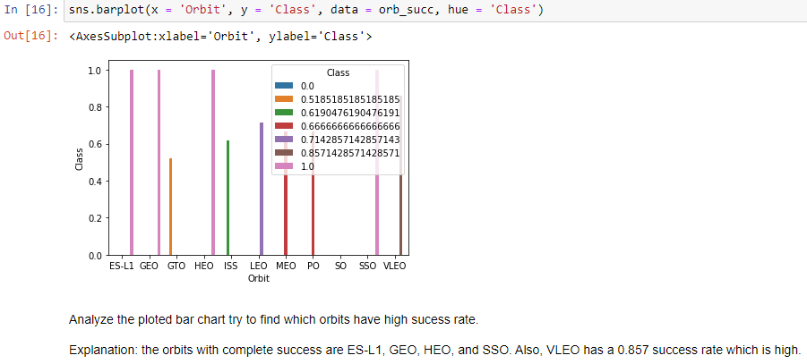
Success Rate vs. Orbit Type Bar Chart
Even with these high success rates, we need more data; i.e., more launches into these orbits.

Slide 37
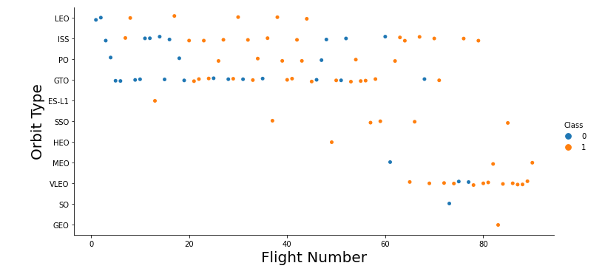
Flight Number vs. Orbit Type Scatter Plot
In the above plot, we observe that in the LEO orbit, success improves with the number of flights. In the GTO, there is also improvement with flight number. VLEO has very good success rate as flight number increases.

Slide 38
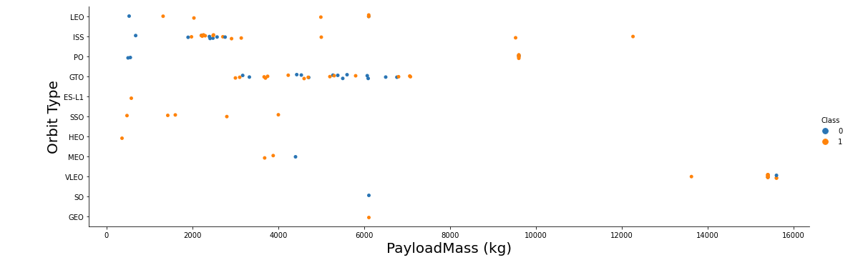
Payload vs. Orbit Type Scatter Plot
We see that in orbits LEO, ISS, PO, SSO, and VLEO successful 1st stage recovery improves with PayLoad Mass.
In GTO, successes are mixed. More data are needed especially in orbits ES-L1, HEO, MEO, SO, and GEO.

Slide 39
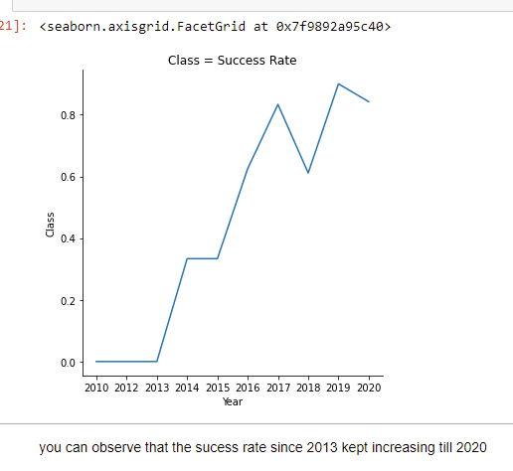
Launch Success Yearly Trend Line Chart

Slide 40
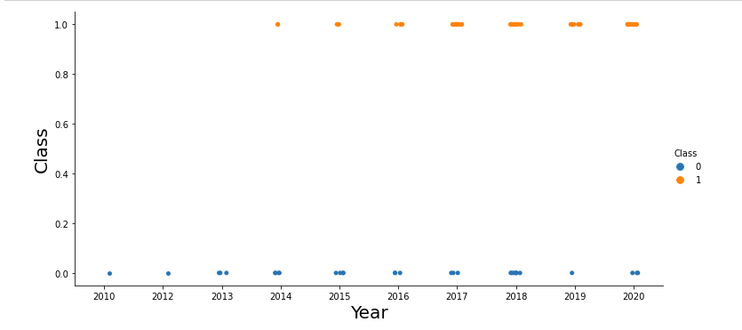
Launch Success Yearly Trend Scatter Plot
By the density of the orange ‘Class’ dots we see successes improved with year of the launch.
Still there were quite a few failures in 2018.

Slide 41
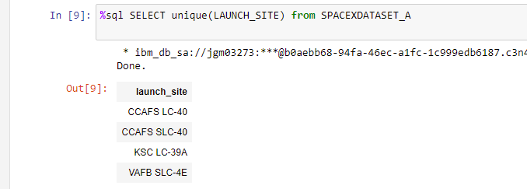
All Launch Site Names SQL Query
Using our sql SPACEXDATASET_A we queried unique launch site names. There are 4 sites represented
In the SpaceX dataset we are working with.

Slide 42
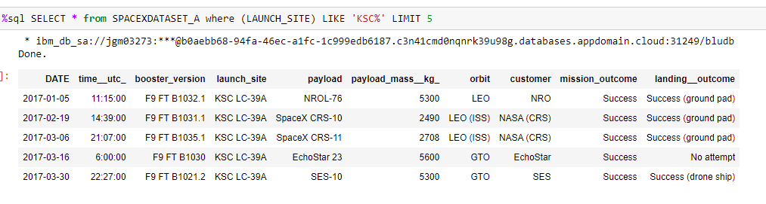
Launch Site Names Begin with 'KSC’ SQL Query
Using our sql SPACEXDATASET_A we selected all the launches from ‘launch_site’ KSC LC-39A. The query could have selected all the launch data for KSC, but we displayed only the 1st five launches.

Slide 43
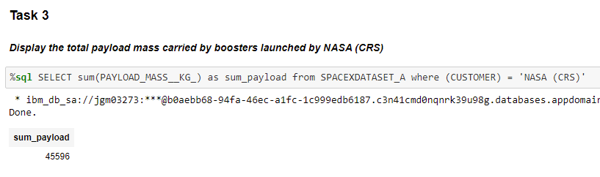
Total Payload Mass SQL Query Result
The total payload mass launched by SpaceX for the NASA (CRS) customer is 45,596 kilograms
using the %sql query (above).

Slide 44
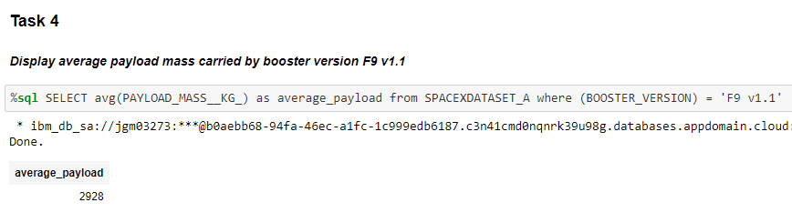
Average Payload Mass by F9 v1.1 SQL Query
The average payload mass for launches using the F9 v1.1 booster is 2,928 kilograms.

Slide 45
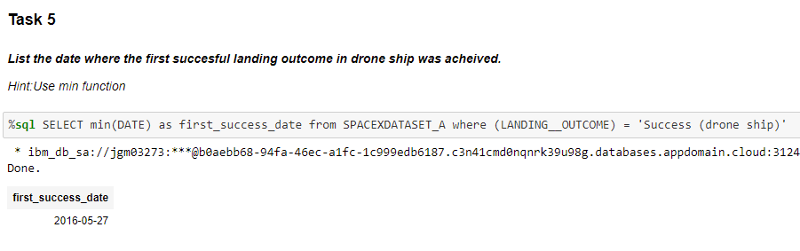
First Successful Ground Landing Date Query
The date for the first successful 1st stage landing on drone ship was May 27, 2016 using
SELECT min(DATE) query.

Slide 46
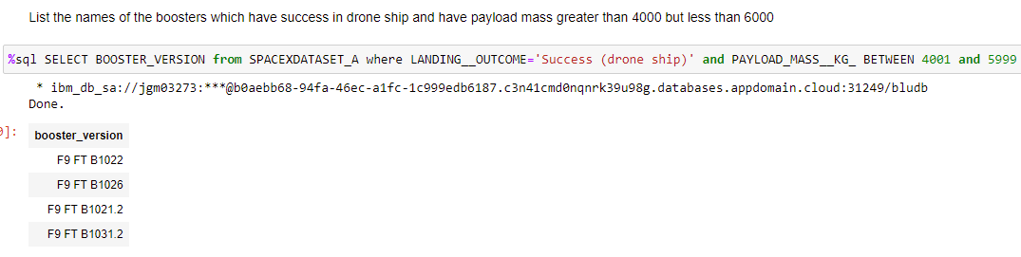
Successful Drone Ship Landing with Payload between 4000 and 6000 Query Result
This query returns the four booster versions that had successful ‘drone ship’ landings and a payload mass between 4000 and 6000 noninclusively.

Slide 47
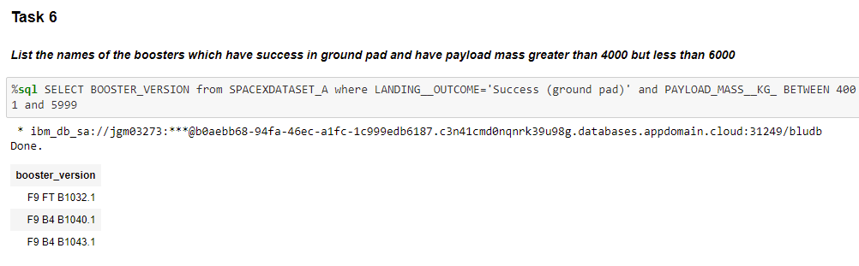
Successful Ground Pad Landing with Payload between 4000 and 6000 Query Result
This query returns the three booster versions that had successful ‘ground pad’ landings and a payload mass between 4000 and 6000 noninclusively.

Slide 48
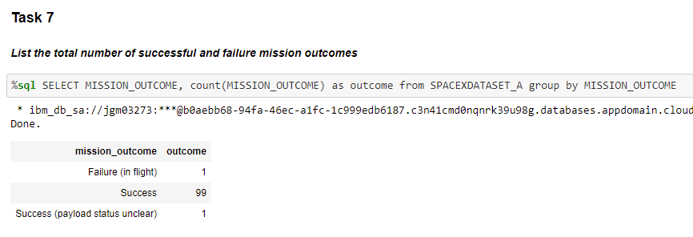
Total Number of Successful and Failure Mission Outcomes Query Result
Need to be careful to distinguish between ‘mission outcome’ and ‘landing outcome’. This query returns a
count of each mission outcome. There are 100 successful ‘mission outcomes’ and one (1) failure ‘mission
outcome’ in this SPACEXDATASET_A.

Slide 49
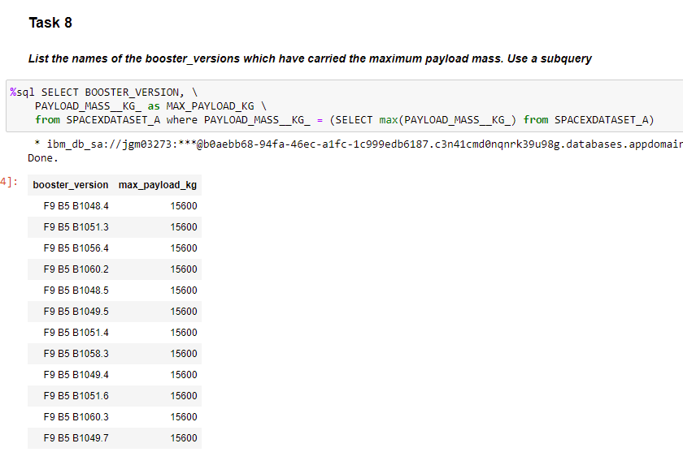
Boosters That Carried Maximum Payload Query Result
This query selects the data about booster versions that
carried the maximum payload mass of 15,600 kg.
These booster versions appear to be similar
(of the F9 B5 B10xx.x configuration).
From this limited data, It appears that payload mass correlates
with the booster version that is used.

Slide 50
2015 Launch Records
We list the records which will display the month names, succesful landing_outcomes in ground pad, booster versions, launch site for the months in year 2017
We present our query result(s) with a short explanation here
Please Note: This template page requests ‘2015 Launch Records’. Then also requests ‘records …. for the months in year 2017’. Both are presented in the following pages.

Slide 51
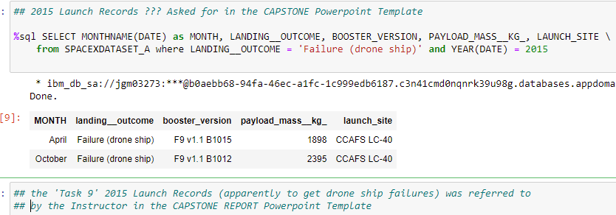
2015 Launch Records (‘drone ship’ Failures) Query Result
The above %sql query selected two ‘drone ship’ failures of Falcon 9 first stage recovery in 2015. Both were
launched from CCAFS LC-40. Also, this result may indicate weakness of F9 v1.1 boosters for drone
ship recoveries.

Slide 52
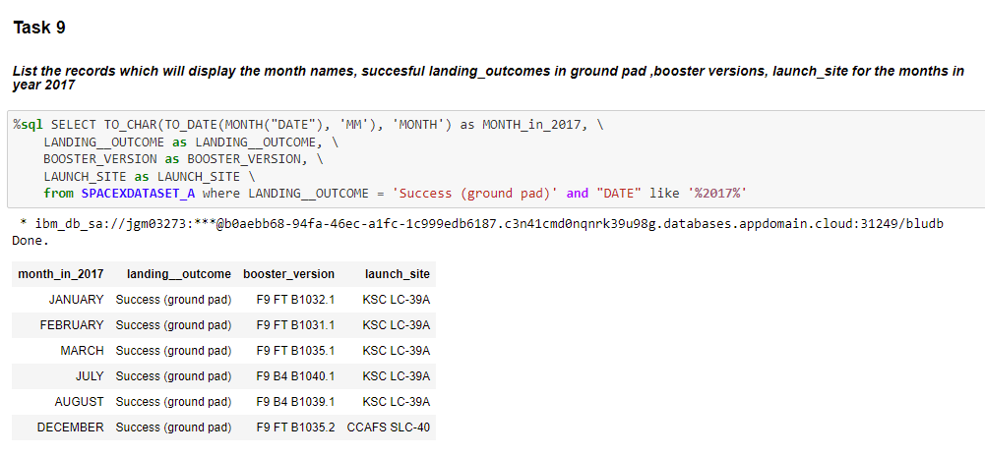
2017 Launch Records (‘ground pad’ Successes) Query Results
This query shows successful first stage recovery of F9 FT and F9 B4 type boosters using ground pad
landings. Also, use of Launch Site KSC LC-39A appears to support successful recoveries in ground pad.

Slide 53
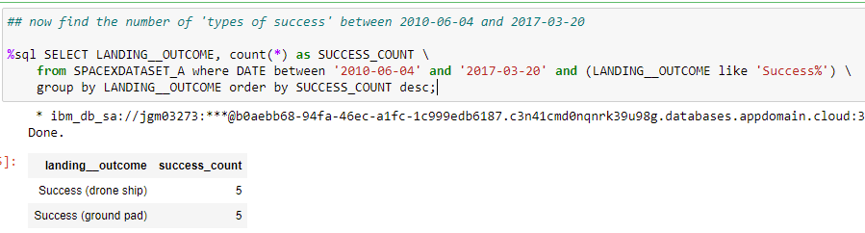
Rank Landing Outcomes Between 2010-06-04 and 2017-03-20 Query Result
‘drone ship’ and ‘ground pad’
This query returns the list of successful Landings between 2010-06-04 and 2017-03-20. Used ‘group by’ to filter landing outcomes.
There were five (5) ‘drone ship’ successes and five (5) ‘ground pad’ successes between 2010-06-04 and 2017-03-20.

Slide 54
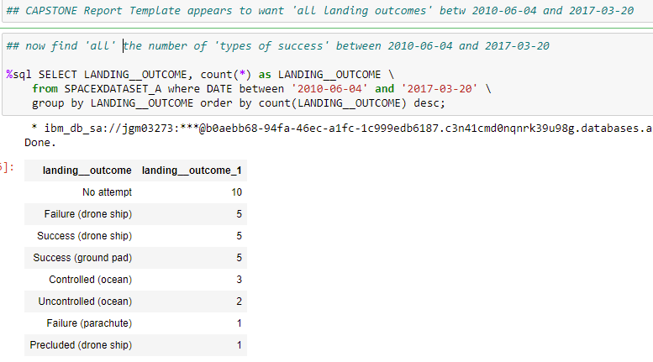
Rank ALL Landing Outcomes Between 2010-06-04 and 2017-03-20 Query Result
This query returns the list of all
1st stage ‘landing outcomes’ between
2010-06-04 and 2017-03-20.
We used ‘group by’ to filter landing outcomes.
There were 10 ‘no attempts’ to do 1st stage
Recoveries AND there are 6 named failures between 2010-06-04
and 2017-03-20. Not sure what ‘Precluded (drone ship)’ means.

Slide 55

Section 3

Slide 56
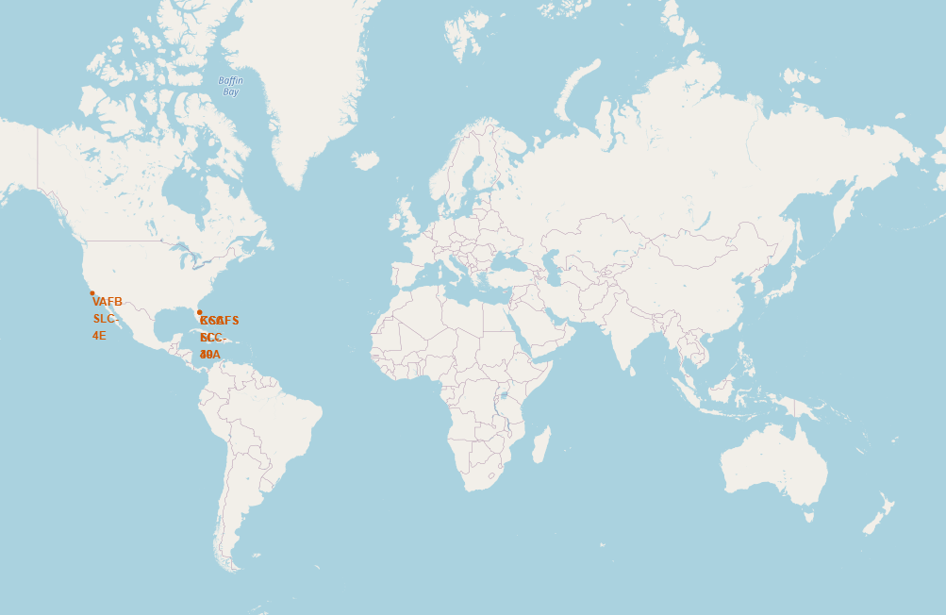
Global (Folium) Map of All SpaceX Falcon 9 Launch Sites
SpaceX Falcon 9 Launch Sites
are shown on this Map.
One site is on the Pacific Coast
of the United States in the
Vandenberg Base area of
California.
There are three (3) sites on
the Atlantic Coast in the Cape
Canaveral area of Florida.

Slide 57
Folium Markers of Launch Site Successes/Failures
The next two slides show example results for two of the four Launch Sites. The Folium maps show the
two Launch Sites and immediate vicinity with color coded markers for1st stage landing outcomes
after launch.
The green markers indicate successes.
The red markers indicate failures.

Slide 58
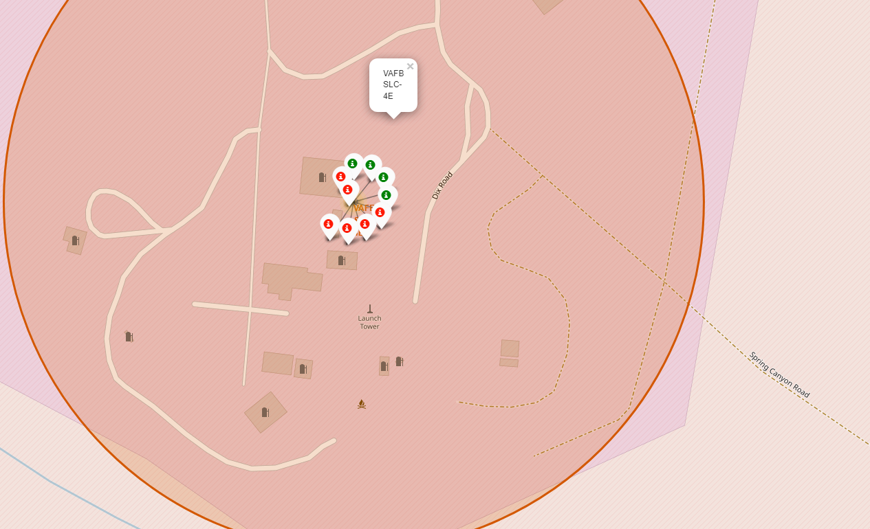
Folium Markers of Launch Site Successes/Failures
This map shows Launch Site VAFB SLC-4E and immediate vicinity with color coded 1st stage landing outcomes
after launch.
The four green markers indicate successes.
The six red markers indicate failures.
Only 40% of the launches from VAFB SLC-4E resulted in successful landing outcomes.

Slide 59
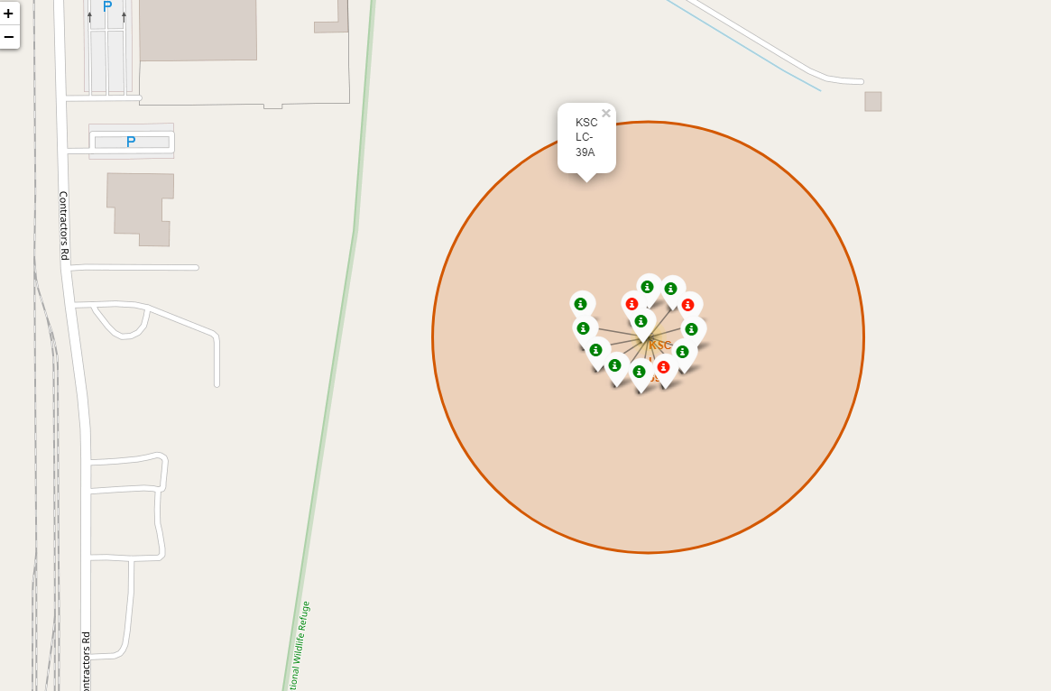
Folium Markers of Launch Site Successes/Failures (cont’d)
This map shows Launch Site KSC LC-39A and immediate vicinity with color coded 1st stage landing outcomes
after launch.
The ten green markers indicate successes.
The three red markers indicate failures.
77% of the launches from KSC LC-39A resulted in successful landing outcomes.

Slide 60
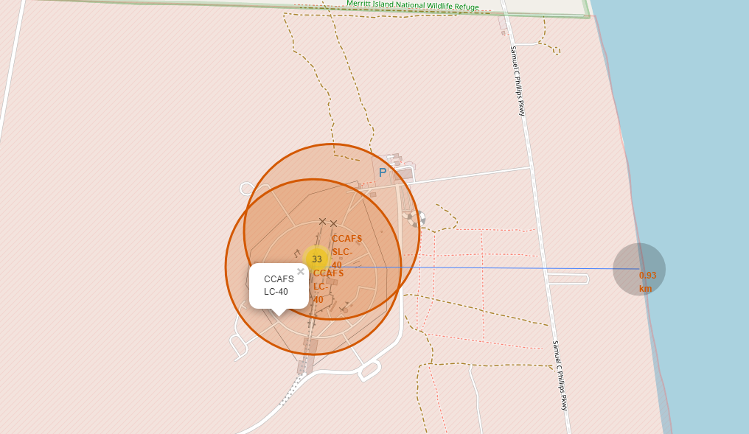
Folium Map Distance CCAFS LC-40 to Coastline
This map shows Launch Site CCAFS LC-40 distance from the Atlantic Coastline. The distance is 0.93 km as shown by the gray circle marking the coast point.
Are launch sites in close proximity to coastline? Explanation : Yes. Launch Site CCAFS LC-40 is just 0.93 km from the Atlantic Coast. While Launch Site CCAFS SLC-40 appears to be less than 0.93 km from the Atlantic Coast.

Slide 61
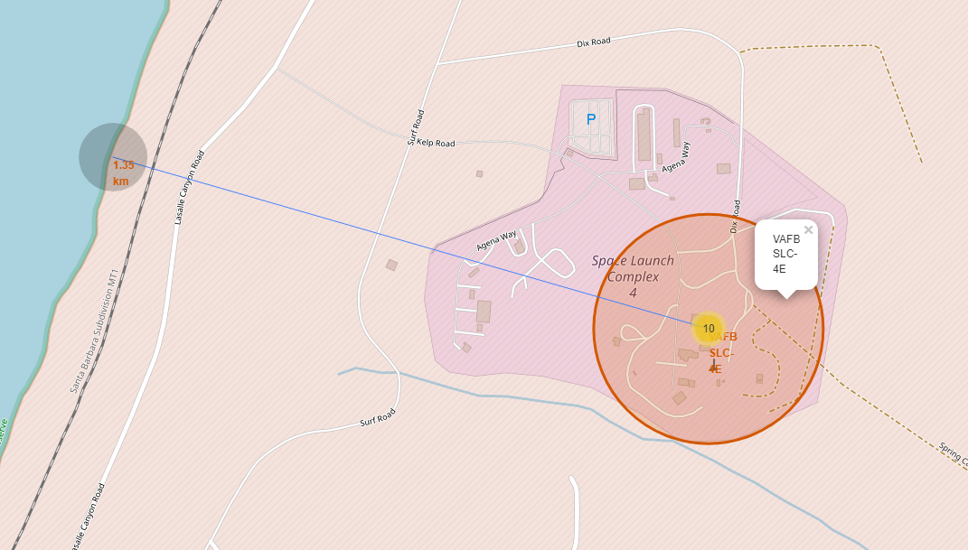
Folium Map for Distance VAFB SLC-4E to Coastline
This map shows Launch Site VAFB SLC-4E distance from the Pacific Coastline. The distance is 1.35 km as shown by the gray circle marking the coast point.
Are launch sites in close proximity to coastline? Explanation : Yes. Launch Site VAFB SLC-4E is just 1.35 km from the Pacific Coast for directing Falcon 9 launches toward the ocean
in case of failure after launch.

Slide 62
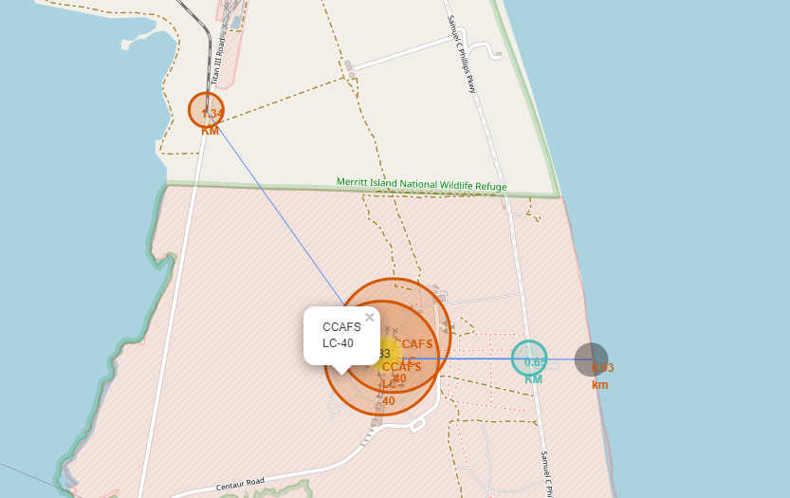
Folium Showing Proximities of RR, hwy to CCAFS LC-40
Launch Site CCAFS LC-40 distance to the NASA Railroad is 1.34 km as shown by the small orange circle marking the end of the spur.
CCAFS LC-40 distance to Sam C Phillips Pkwy is 0.65 km (light blue circle).
Are launch sites in close proximity to RR and hwy? Explanation : Yes. Launch sites are close to railways for large equipment hauling. Launch sites are close to highways for hauling needed equipment and personnel.

Slide 63
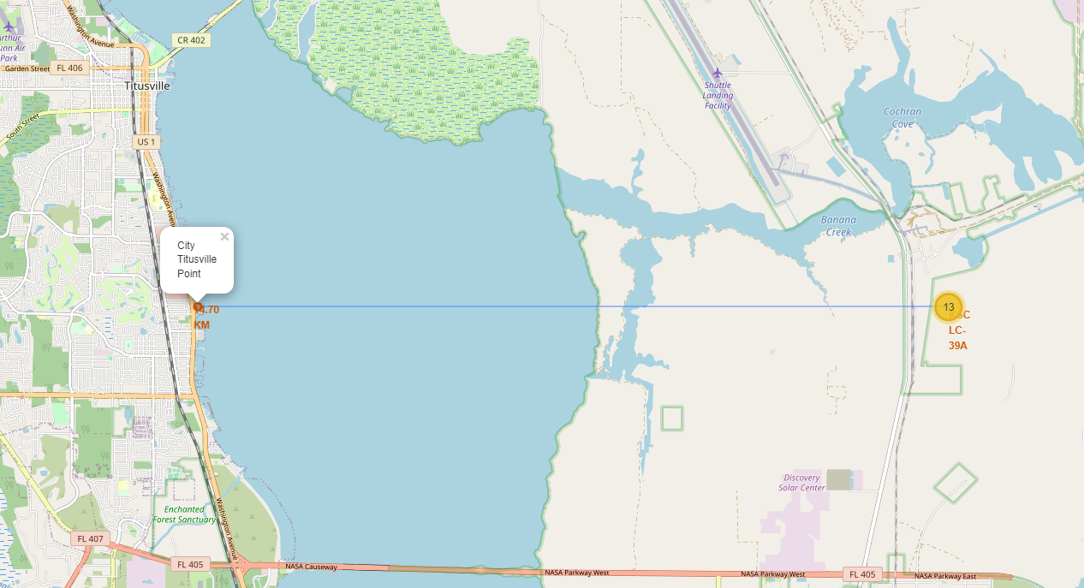
Folium Map shows KSC LC-39A Close to Titusville
We see that Launch
Site KSC LC-39A is
near the city of
Titusville.
More detail about this
On the next slide.

Slide 64
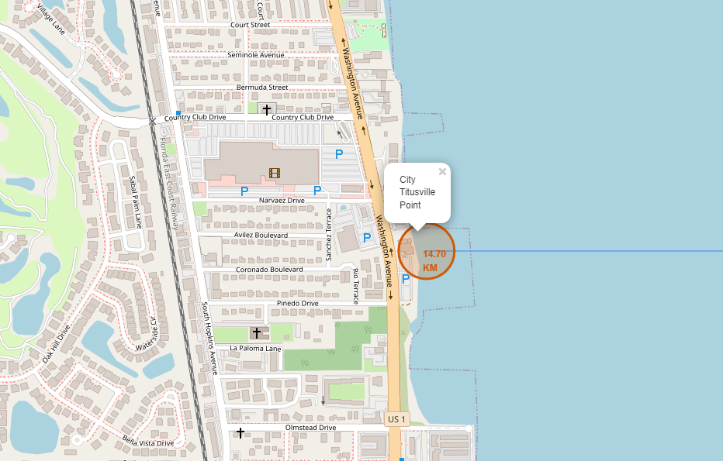
Folium Map shows KSC LC-39A Close to Titusville (cont’d)
A close-up of the previous slide shows that Titusville, Fl is 14.70 km (only 9.2 mi) from KSC LC-39A.
Are launch sites in close proximity to cities? Explanation : Yes. A launch site, esp. KSC LC-39A, is close to Titusville. This is potentially dangerous in case of a launch failure.

Slide 65

Section 4

Slide 66
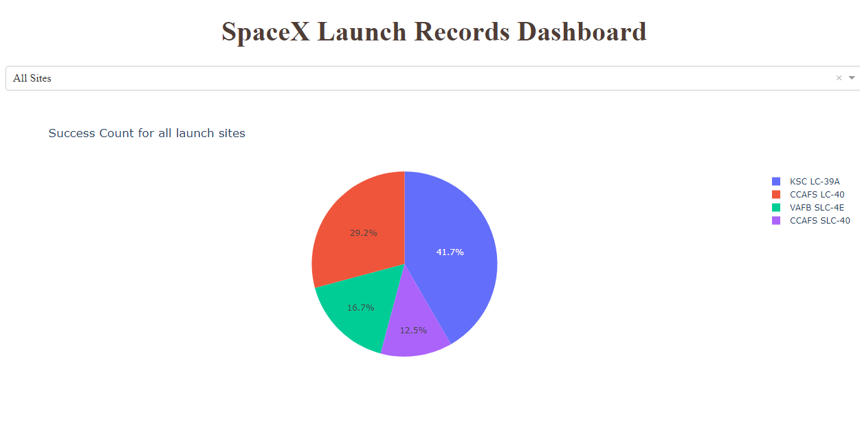
Launch Success % for All Sites (Pie Chart)
Of all successful Falcon 9 first stage recoveries, Launch Site KSC LC-39A has 41.7% of them.

Slide 67

Launch Success % for KSC LC-39A (Pie Chart)
Launch Site KSC LC-39A has a 77% success ratio for first stage recoveries.

Slide 68

Screenshot of Payload vs. Launch Outcome scatter plot
With the rangeslider set at 0 – 6,000 kg payload range, we see that Booster Version FT has a good success
rate for the entire payload range with some weakness at high payloads. Whereas Booster v1.1 has a poor
success rate over the entire 0 – 6,000 kg payload range. Booster v1.0 has no successes even at low payload
(for this payload range).

Slide 69

Section 5

Slide 70
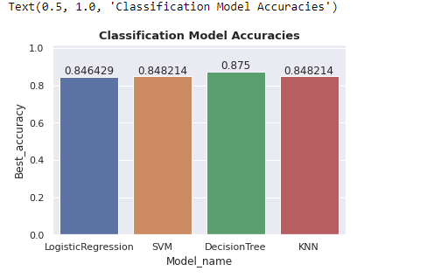
Built Classification Model Accuracy
The decision tree classifier is the model with the highest classification accuracy using the ‘best_accuracy’ metric from sklearn.
‘Best_accuracy’ for the decision tree classifier scores 0.875 on a 0.0 to 1.0 scale.
So with decision tree we predict an 87.5 per cent likely successful landing_outcome for recovering a Falcon 9–type first stage rocket.

Slide 71
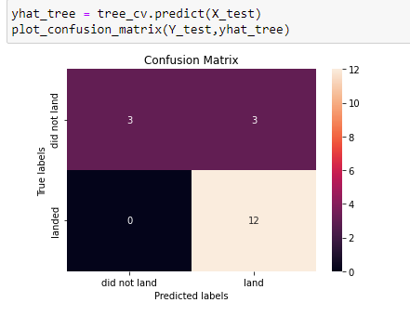
Decision Tree Confusion Matrix
The confusion matrix for the decision tree classifier model shows that the classifier can distinguish between the different classes. The major problem is the false positives i.e., unsuccessful landing predicted as successful landing by the classifier.
Because each classifier tested performed similarly for the given dataset, the confusion matrix turned out to be the same for each model type.
The models predicted 12 successful landings when the ‘true label’ was successful (true positives).
Whereas, the models predicted 3 successful landings when ‘truth’ was unsuccessful (false positives; upper right corner of the matrix).
So, these models consistently ‘over-predicted’ successful landings.

Slide 72
Conclusions (1)
From our SpaceX launch dataset analyses:
Found an increase in success rate for first stage landing outcomes as ‘payload mass’, ‘flight numbers’, and ‘elapsed time’ increased.
Launch Site KSC LC-39A had the highest success rate for first stage landing outcomes (77%).
Launches into Orbits SSO and VLEO had high success for landing outcomes. Launches into orbits ES-L1, GEO, and HEO were also successful, but each had only one launch (i.e., only 1 data point each).
While not directly related to our purpose in analyzing this SpaceX dataset, the launch data revealed a remarkable success rate in ‘mission outcomes’ (100 : 1).
Using booster version Falcon 9 FT resulted in a high success rate for landing outcomes; esp. over the 0 - 6,000 kg payload range (14 successes : 4 failures).

Slide 73
Conclusions (2)
Furthermore, from our SpaceX launch dataset analyses:
Of the 4 classification models (classifiers) we built (LogReg, SVM, DecisionTree, KNN), each predicted 15 of the test set 18 landing outcomes correctly. Whereas, each predicted 3 successful landing outcomes incorrectly (3 false positive predictions).
Each of the 4 classifiers scored well in predicting landing outcomes vis-a’-vis the test dataset using sklearn scoring metrics ‘score’, ‘f1_score’, ‘best_score’ (all scores greater were than 0.8 or 80%).
The DecisionTree classifier scored the best : f1_score = 0.88; best_accuracy = 0.88 (to as high as 0.9)
These accuracies show that SpaceY can successfully use these classifiers to predict first stage landing outcomes.
More data from more Falcon 9 launches should be collected and wrangled to up-date (and verify) the best machine learning model and to improve the prediction accuracy.

Slide 74
Appendix
We include any relevant assets like Python code snippets, SQL queries, charts, Notebook outputs, or data sets that we may have created during this project
Continue

Slide 75
Appendix
1. SpaceX launch data source : List of Falcon 9 and Falcon Heavy launches. Retrieved from
https://en.wikipedia.org/wiki/List_of_Falcon_9_and_Falcon_Heavy_launches
2. GitHub repository url:
https://github.com/efjacobi/IBM-Professional-Certificate-DS-CAPSTONE-efjacobi
3. Thankful Recognition to Instructors and Contributors (IBM Skills Network personnel):
Rav Ahuja, Alex Aklson, Svetlana Levitan, Romeo Kienzler, Joseph Santarcangelo, Azim Hirjani, Yan Luo, Lakshmi Holla, Rav Ahija, Grace Parker, Rachael Jones, Alex Jones, Kathleen Bergner, Bella West, Simer Preet, Lauren Hall, Hunter Bay, Tanya Singh, Om Singh, Malika Singla, Diwakar Chaubey, Duvvana Mrutyunjaya Naidu, Rose Malcom, Jan Findlay, Himanshu Birla, Rishi Pandey, Ayushi Jain, Maureen McElaney, Patrick Titzler, Hafsah Lakhaney, Sonali Surange, Nick Penthreath, Neil McKinnon, Sonali Gupta, Simran Garg, Matt Ockenfelds, Charlie Money, Eboney Hinds, Sunny Anderson, Pradnya B, Lavanya T S

Slide 76
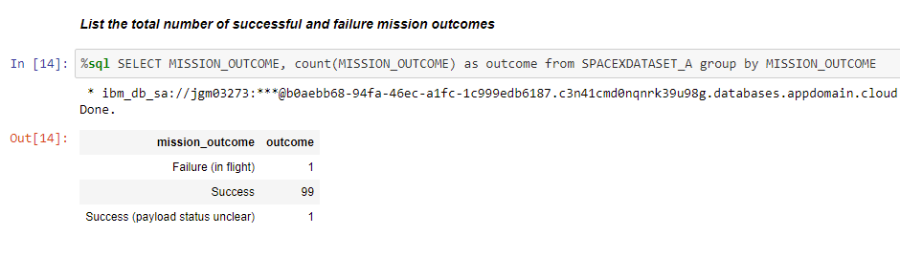

Appendix (cont’d)
4. I found it remarkable that there was such a high success rate for (overall) ‘mission_outcomes’ in the SpaceX
Falcon 9 Launches dataset :

Slide 77
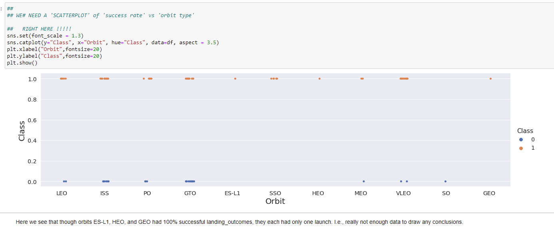
Appendix (cont’d)
5. It is useful to visualize ‘orbit’ vs ‘success Class’ :
Note that 100% ‘success’ in ES-L1, HEO, and GEO is based on only 1 launch into each of those orbits.

Slide 78
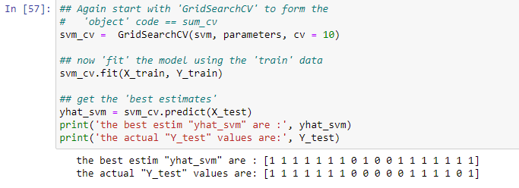
Appendix (cont’d)
6. It is (was) meaningful to display and compare the predictor estimates to the test set values. For example,
for SVM :
We see the ‘incorrectly predicted successful landings’ in positions 9, 12, and 17 of the ‘yhat_svm’ list (vector) i.e., the over-prediction of successful landing_outcomes.

Slide 79


